Slide 1
VIII Annual Ri.MED Symposium
Immunotherapy and Immunoengineering for Diabetes
Camillo Ricordi, MD
Stacy Joy Goodman Professor of Surgery
Distinguished Professor of Medicine
Professor of Biomedical Engineering, Microbiology and Immunology
Director, Diabetes Research Institute and Cell Transplant Program,
University of Miami

Slide 2
Immunoengineering and Convergence Science
Krishnendu Roy
Center for Immunoengineering at Georgia Tech
May 05, 2014 | Atlanta, GA
… we are now experiencing a revolution in how we think of human diseases and how we approach to solve them. I don’t think I know of any disease where the immune system is not intricately involved. From a simple fever and cough to cancer and HIV, from a rash or a cut to autoimmune and cardiovascular diseases; immunology plays a central role in keeping us healthy and manifesting our diseases. Our fundamental knowledge of biology and how cells, organs and systems physiology work together have increased exponentially over the past two decades and with that has come much appreciation of immunological balance and the potential of modulating ones immune system to treat devastating diseases like cancer, multiple sclerosis, diabetes, lupus, HIV and others.

Slide 3
Immunologists, biologists and clinicians have converged with physicists, chemists, computational scientist as well as chemical, electrical, mechanical and bioengineers to launch an all-out attack against devastating diseases using the immune system as their fundamental weapon.
Georgia Tech launched what could be the first ever Center for Immunoengineering in the nation.
Georgia Tech and Emory launched the broader Georgia Immunoengineering Consortium (GIEC). With over 60 faculty members from both universities the GIEC is poised to become the world leader in creating breakthrough engineering tools, methods and solutions for understanding and modulating the immune system and developing new solutions for personalized and predictive health-care.

Slide 4
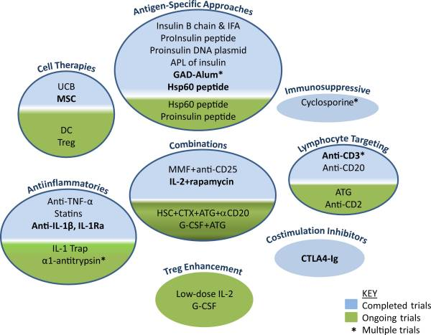
IMMUNE INTERVENTION IN T1D: state of the art and future direction
Bystander effect
Multiple dose of vaccine
Risk of antigen spread
Not sufficient alone
Induces state of immunosuppression
Needs indefinitely administration
Immunosuppressive effect only for few weeks after treatment
Disease acceleration
Suboptimal administration of the agents
Induce state of immunosuppression
No durable effect even if indefinitely administered
Modified from Staeva T.P et all diabetes January 2013, PMCID: PMC3526042

Slide 5
Featured Article:
Administration of CD4⁺CD25^{high}CD127⁻ Regulatory T Cells Preserves β-Cell Function in Type 1 Diabetes in Children
Natalia Marek-Trzonkowska, V.M.D., Ph.D., Małgorzata Myśliwiec, M.D., Ph.D., Anita Dobyszuk, M.S.C., Marcelina Grabowska, M.S.C., Ilona Techmańska, M.D., Jolanta Juścińska, M.D., Ph.D., Magdalena A. Wujtewicz, M.D., Ph.D., Piotr Witkowski, M.D., Ph.D., Wojciech Młynarski, M.D., Ph.D., Anna Balcerska, M.D., Ph.D., Jolanta Myśliwska, M.D., Ph.D., Piotr Trzonowski, M.D., Ph.D.
Diabetes Care
Volume 35: 1817-1820
September, 2012

Slide 6
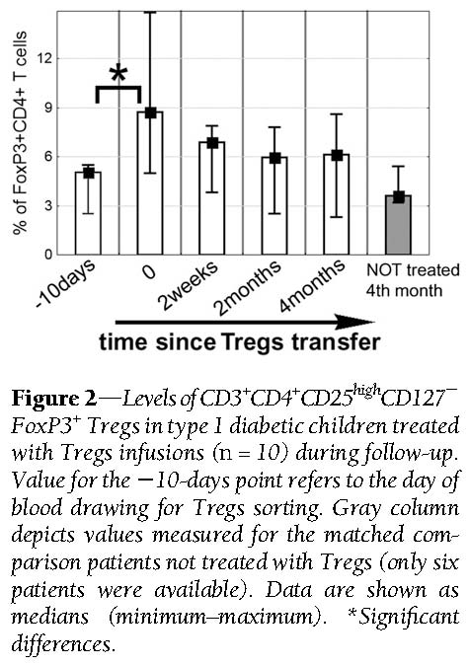
Marek-Trzonkowska N et al. Diabetes Care 2012;35:1817-1820
Notes:
Figure 2dLevels ofCD3⁺CD4⁺CD25^{high}CD1272FoxP3⁺ Tregs in type 1 diabetic children treated with Tregs infusions (n = 10) during follow-up. Value for the210-days point refers to the day of blood drawing for Tregs sorting. Gray column depicts values measured for the matched comparison patients not treated with Tregs (only six
patients were available). Data are shown as medians (minimum–maximum). *Significant differences.

Slide 7
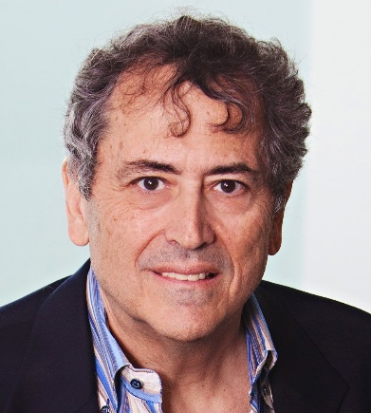
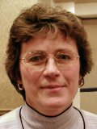
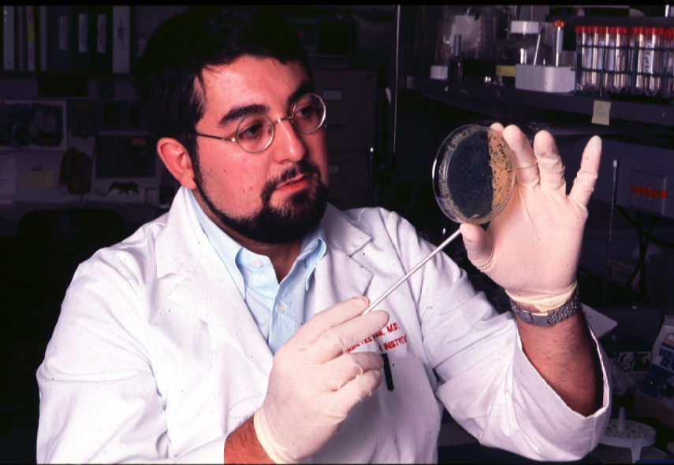

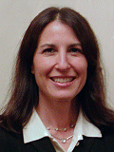
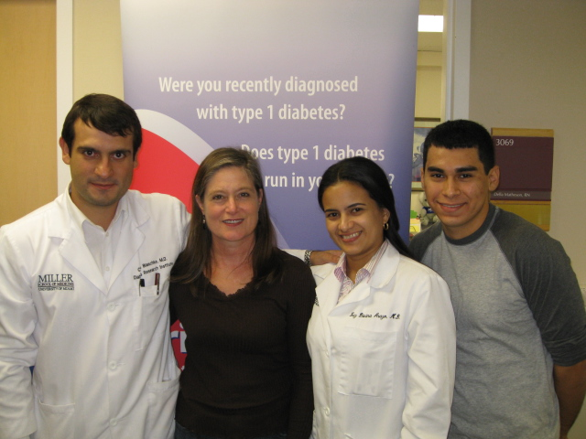
Jay Skyler
Jennifer Marks
Alberto Pugliese
Jay Sosenko
Lisa Rafkin
Della Matheson
Carlos Blaschke
Funding Sources:
NIH, DRIF, JDRF, ADA. Industry
Type 1 Diabetes TrialNet
Oral insulin for prevention of T1D
Abatacept (co-stimulation blockade) for prevention of T1D
Teplizumab (anti-CD3) for prevention of T1D
ATG-GCSF in new-onset T1D*
Regulatory T-cells in new-onset T1D*
Dendritic cells in new-onset T1D*
Other studies: Viacyte hESCs in T1D; Low-dose IL-2 in T1D

Slide 8
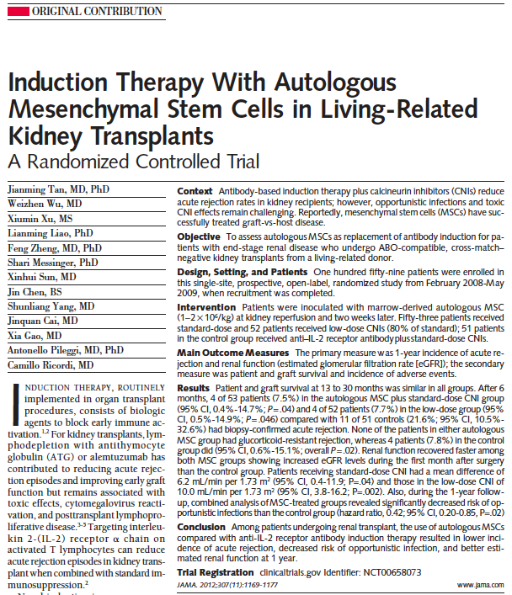
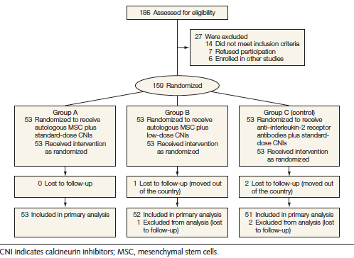
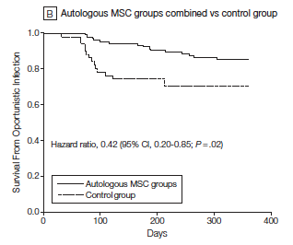

Early graft function
1-yr graft function
Acute rejection
Opportunistic Infections

Slide 9
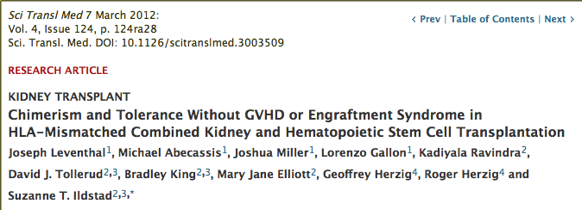
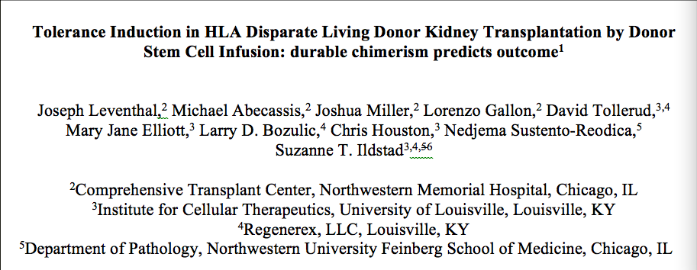

Slide 10
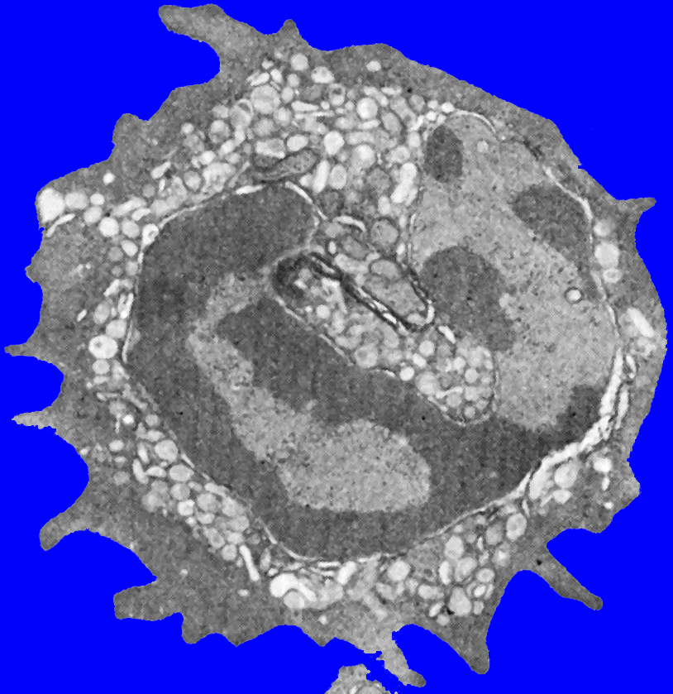
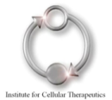

Definition of the Facilitating Cell
CD8⁺
αβ/γδ TCR⁻
Distinct from Stem Cell
65% resemble tolerogenic plasmacytoid dendritic cells (B220⁺/CD11c⁺/CD116⁻)
Induces antigen-specific T_{reg}
Induces B_{reg}
Kaufman et al, Blood 1994, 84(8):2436-2446
Fugier-Vivier et al, J Exp Med 2005, 201(3):373-383
Huang et al, Blood 2010, 117(8):2494-2905
Notes:
10
10
NW Talk_May 19
10
Marvina Lewis and high schoolers 01_30_07
10

Slide 11
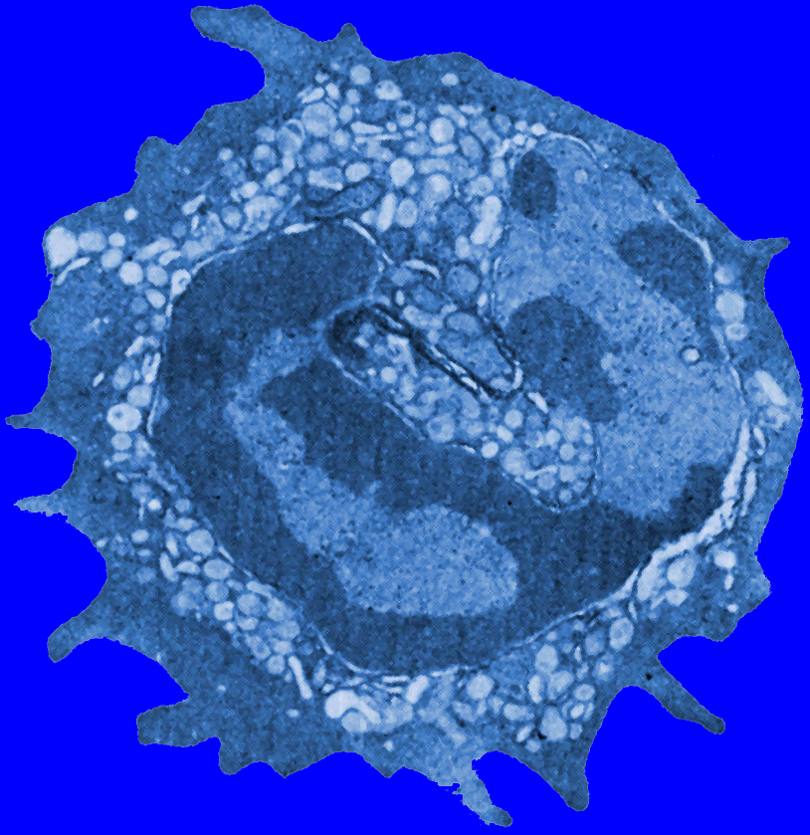
Facilitating Cell Mechanism of Action
Induces IL-10⁻ B_{reg} in vitro
Induces antigen-specific
T_{reg} in vivo
Taylor KN, J Immunol 2007, 15;179(4):2153-62
Huang Y, Blood 2011, 117(8):2494-2505
Enhances homing
and migration
DOCK2
Wen, Stem Cells, 2014 32(10):2732-43
Stem
Cell
Facilitating
Cell
Prevents apoptosis of HSC
Rezzoug F, J Immunol 2008, 180(1):49-57
Clonogenicity of HSC
Fugier-Vivier I, J Exp Med 2005, 201(3):373-383
Rezzoug F, J Immunol 2008, 180(1):49-57
Prevents GVHD in mice
Taylor KN, J Immunol 2007, 15;179(4):2153-62
Notes:
11
11
YPO 111008
11
Pfeifer 11_28_05
11

Slide 12

Mechanism by which FC Enhance HSC Engraftment without GVHD
NK FC
P-pre DC FC
Naïve CD4⁺ T cells
Cell:Cell
interaction
IL-10
IL-6
CD19 FC
CD3e FC
Cell:Cell
interaction
HSC
TNF-α
Other trophic factors
Treg
Tr1
T_{reg}: CD4⁺CD25⁺FoxP3⁺
Tr1: CD4⁺CD25⁻FoxP3⁻IL-10⁺

Slide 13
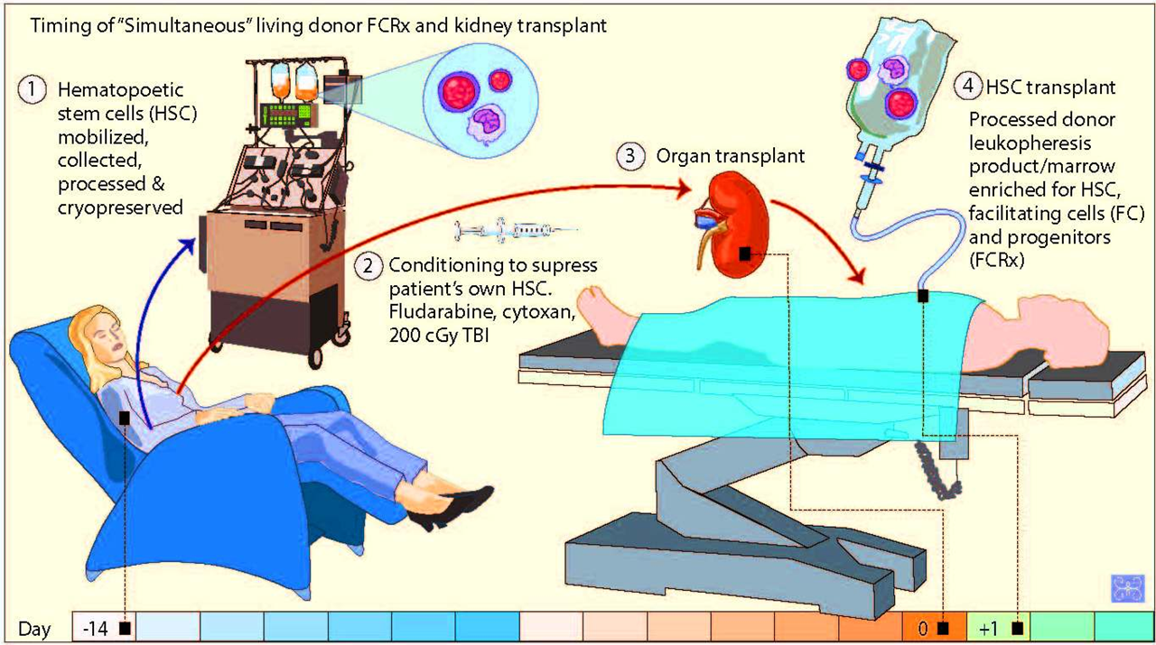
Simultaneous FCRx + Kidney Transplant
Conditioning to suppress Patient’s own Immune system.
Fludarabine, Cytoxan, 200cGy TBI
Leventhal J et al, J Clin Pharmacol Thera, September 2012

Slide 14


Molecular Engineering for Antigen Delivery in Induction of Antigen-Specific Tolerance
Jeffrey A. Hubbell
Institute of Bioengineering, Ecole Polytechnique Fédérale de Lausanne
Institute for Molecular Engineering, University of Chicago

Slide 15
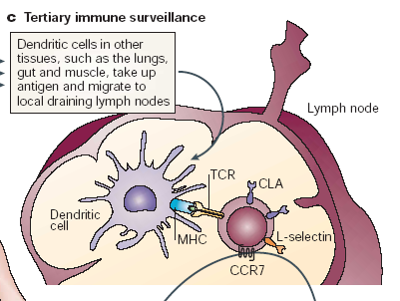
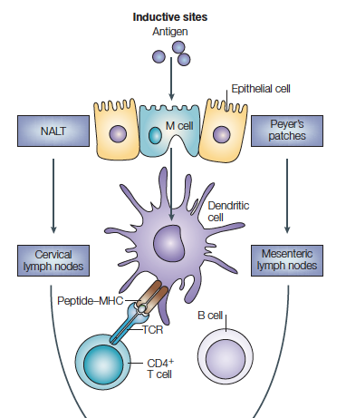
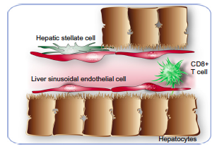
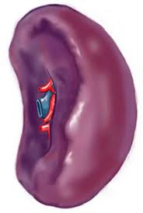
Antigen Delivery in
Inverse Vaccination
Lymph Nodes (invader/self)
Mucosae (invader/friendly)
Liver (mostly self)
Spleen (self/invader)

Slide 16
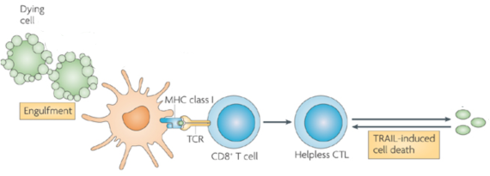
Antigen Collection from Apoptotic Debris
Cells die all the time. How do we not develop immunity to dying cells? Why don’t we all develop autoimmunity?
Debris from dying cells induce peripheral tolerance:
Antigen-presenting cells doing surveillance
Deleting or exhausting the antigen-specific T cells
Very direct, antigen-specific modulation of the immune system

Slide 17

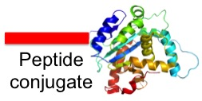

Exploiting Erythrocyte Targeting
Tolerogenic presentation of antigens from apoptotic cells has been demonstrated: SD Miller and others
Develop a molecular implementation to exploit eryptosis
Two implementations:
S. Kontos et al., PNAS 2013,110:E60-8.
Glycophorin A as a target

Slide 18
Exploiting Erythrocyte Targeting
Tolerogenic presentation of antigens from apoptotic cells has been demonstrated: SD Miller and others
Develop a molecular implementation to exploit eryptosis
Two implementations:
S. Kontos et al., PNAS 2013,110:E60-8.
Glycophorin A as a target

Slide 19
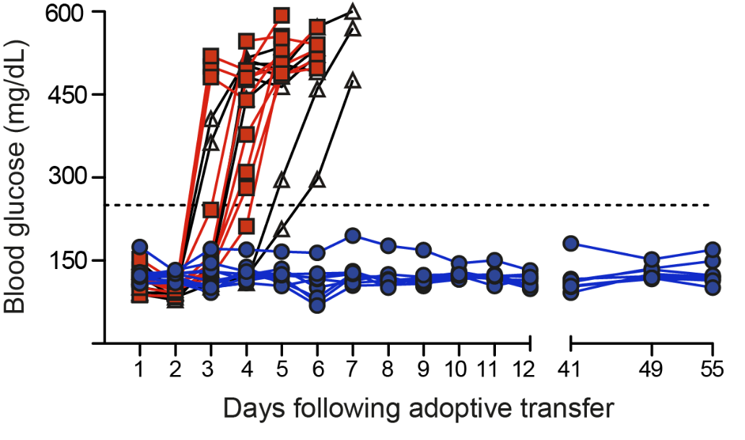
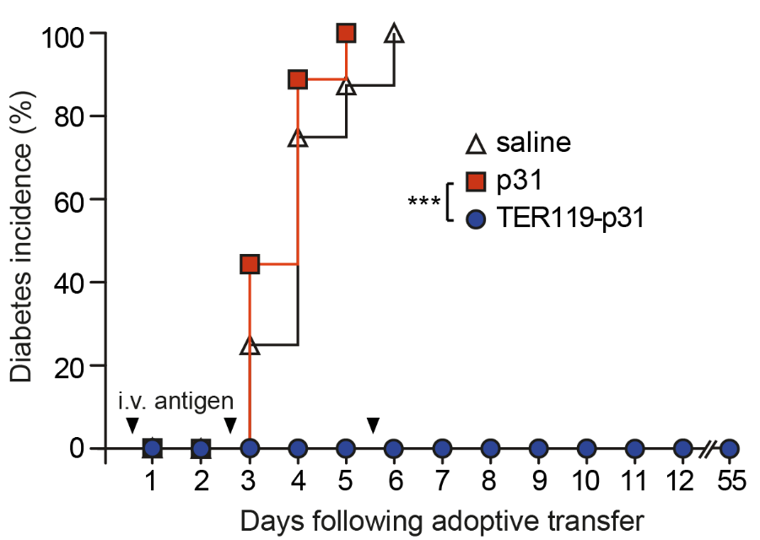
Deletion of Activated CD4⁺ T cells
BDC2.5 CD4+ T cell adoptive transfer model of T1D
Your Favorite Antigen
10 µg doses
S. Kontos et al., PNAS 2013,110:E60-8.

Slide 20
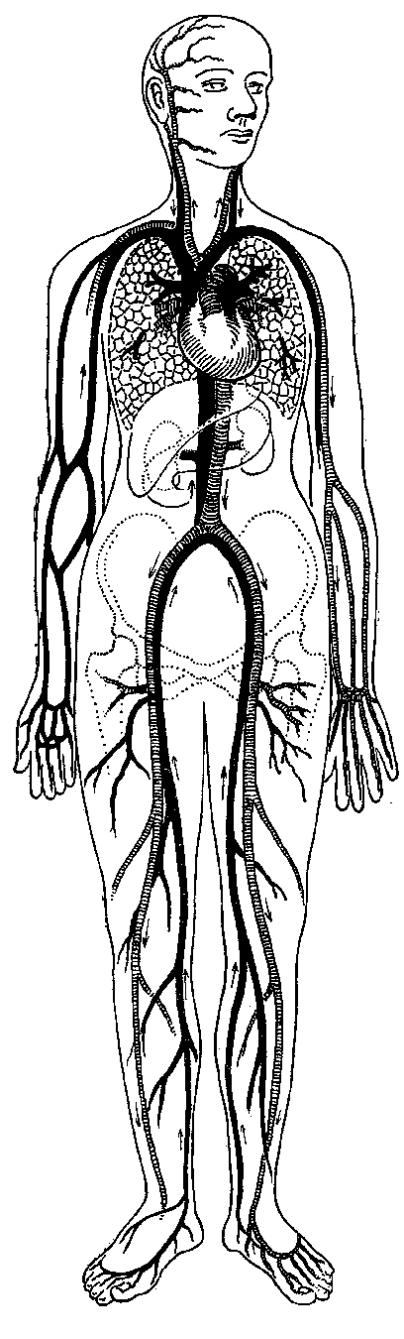
NIH-funded, IRB- and FDA-approved Safety Study
(R33-DK-63499-03--IRB0509115--IND#12858)
To confirm that intradermal administration of autologous diabetes suppressive dendritic cells (DC) is safe, non-toxic and without side-effects.
1. Obtain leukocytes via apheresis
2. Engineer DC towards a “diabetes-suppressive” capacity
by providing a mixture of AS-ODN (CD40/CD80/CD86)
-- under GMP/GLP conditions --
Giannoukakis et al. Ped Diabetes 9 (Part II):4, 2008

Slide 21
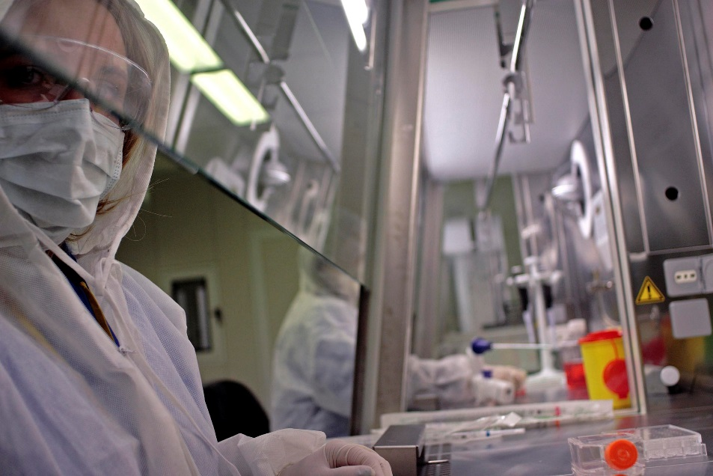
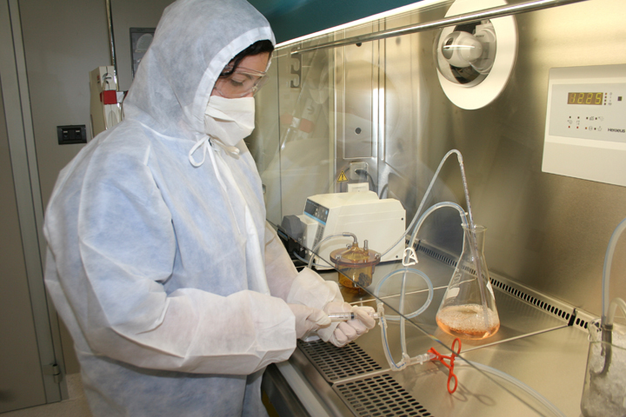
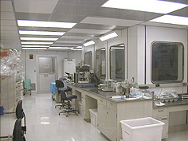
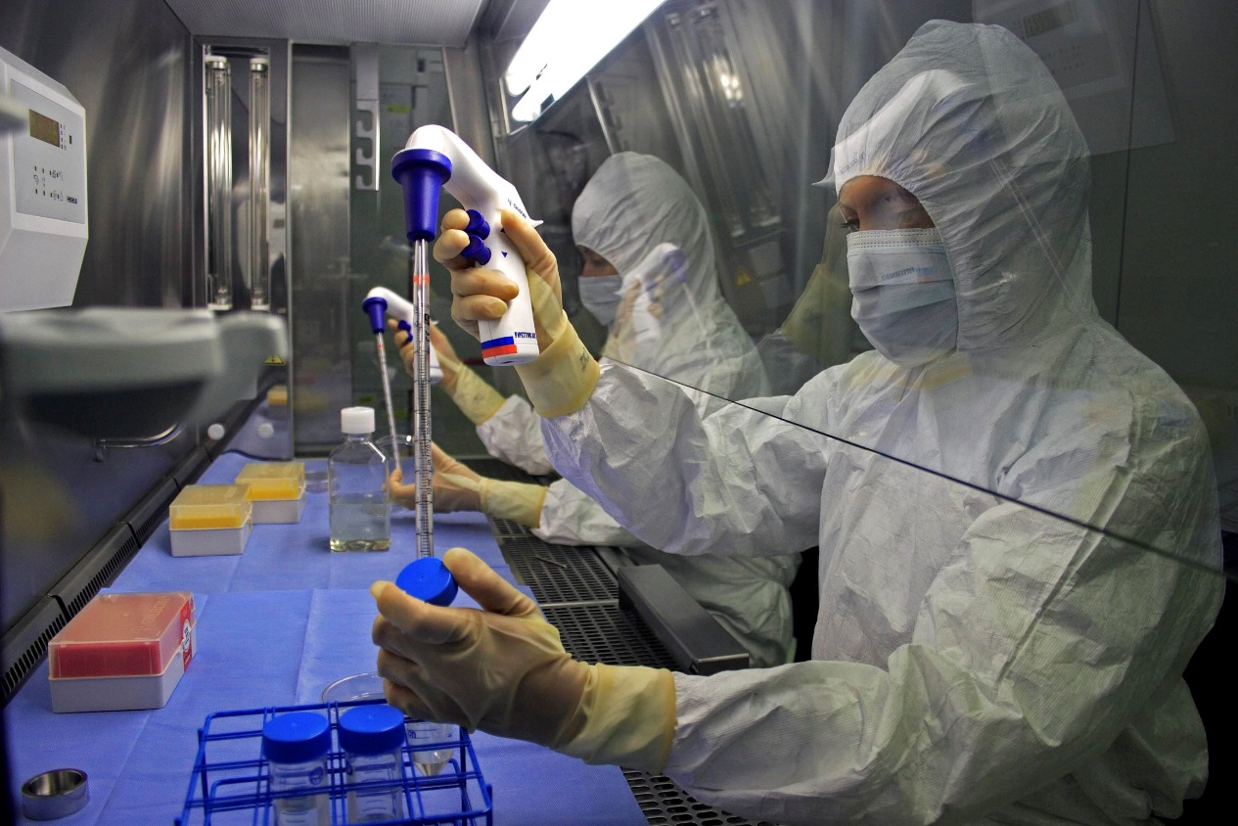
Requirements for DC Isolation:
IMCPL* at Hillman Center
*
(a GMP facility)
*
= Immune Monitoring and Cellular
Products Laboratory
*
= Good Manufacturing Practice

Slide 22
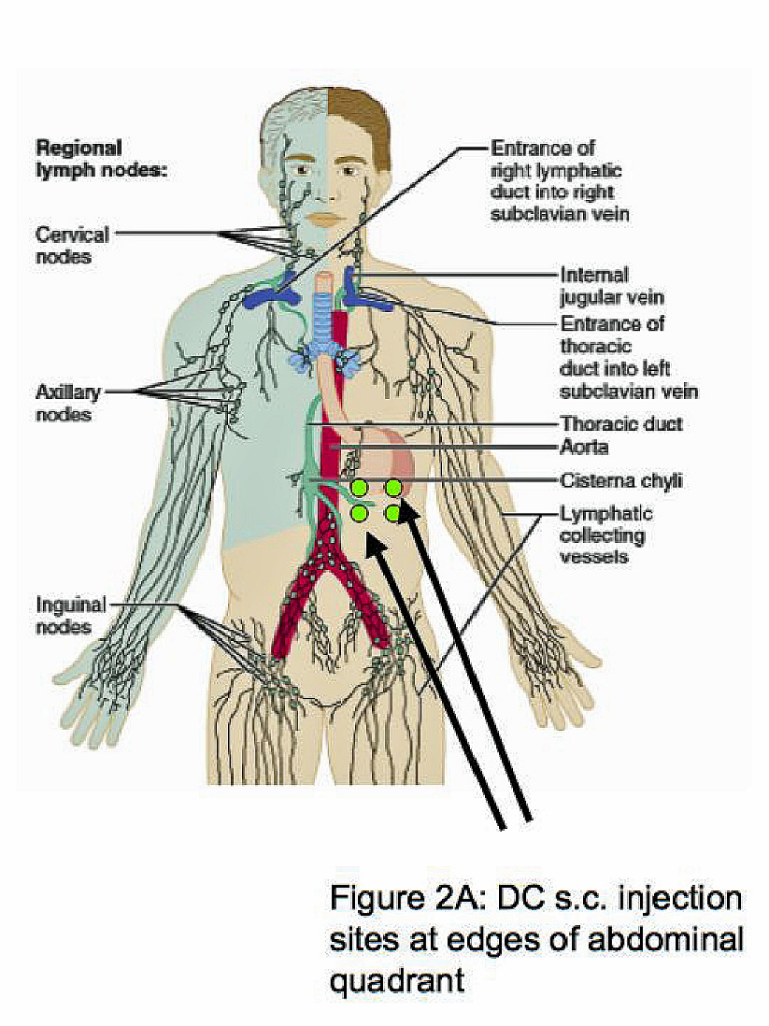
NIH-funded, IRB- and FDA-approved Safety Study
(R33-DK-63499-03--IRB0509115--IND#12858)
To confirm that intradermal administration of autologous diabetes suppressive dendritic cells (DC) is safe, non-toxic and without side-effects.
1. Obtain leukocytes via apheresis
2. Engineer DC towards a “diabetes-suppressive” capacity
by providing a mixture of AS-ODN (CD40/CD80/CD86)
-- under GMP/GLP conditions --
3. Test potency, sterility and divide into individual administration aliquots
4. Administer to volunteer intradermally
5. Immunological, biochemical, physiologic monitoring to establish safety
Giannoukakis et al. Ped Diabetes 9 (Part II):4, 2008

Slide 23
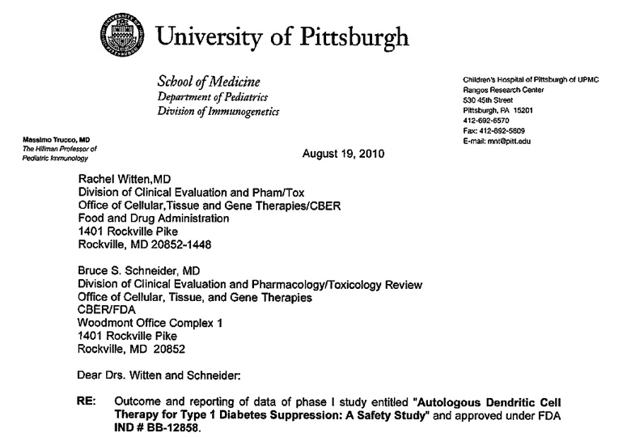
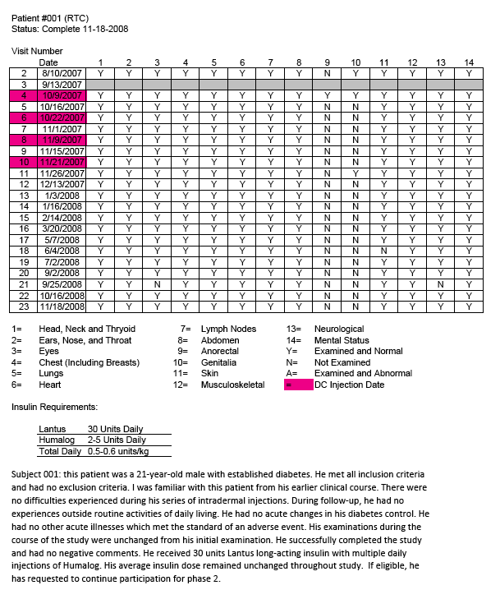
Patient Visit
Schedule

Slide 24
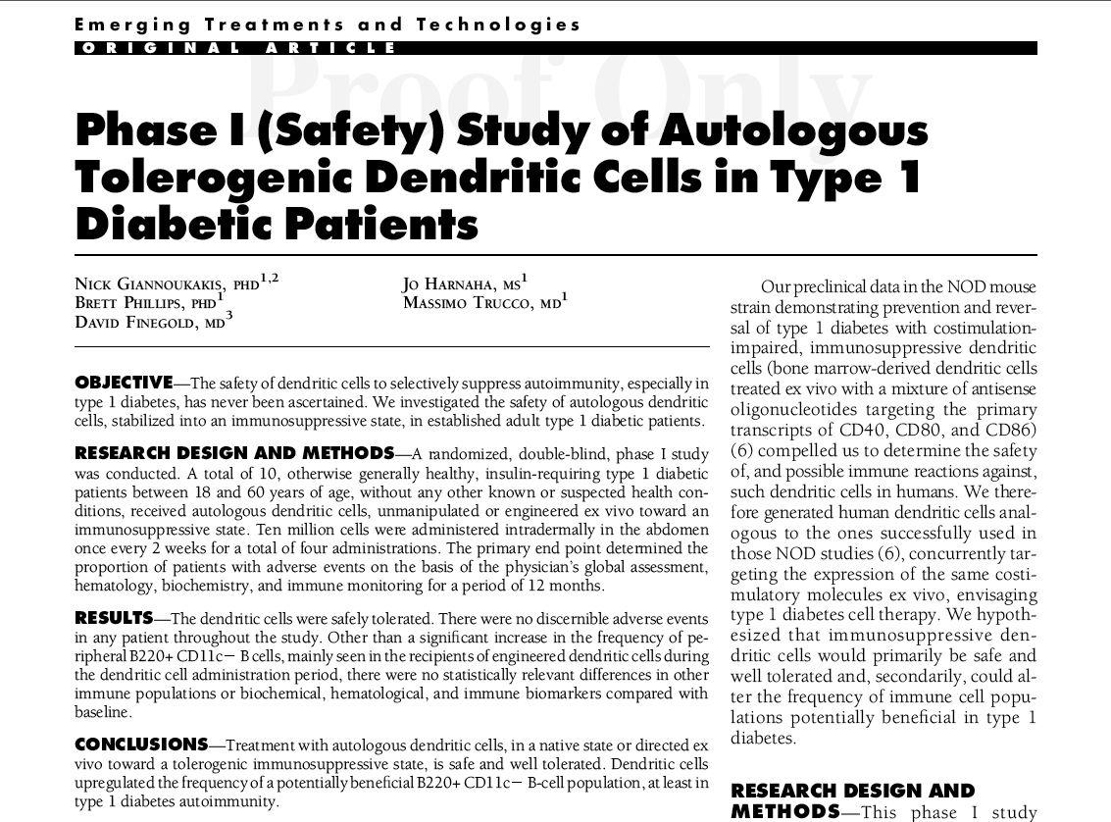
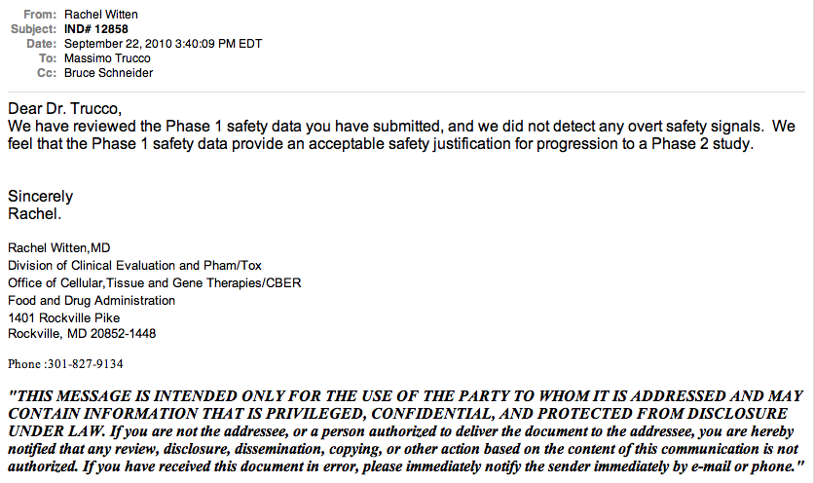

Slide 25
Now that “safety” is confirmed,
“efficacy” should be determined.
Aims of Phase II:
To improve the physiological indices of functional beta cell mass (MMTT; Glucose AUC,C-peptide, HbA1c, Insulin administrations) in New-onset Diabetics and eventually in First Degree Relatives at high risk.
To reduce the titer of, or eliminate the presence of diabetes-associated auto-antibodies.
To increase the prevalence of putative regulatory T- and B-cells.

Slide 26
Combination Low-Dose Antithymocyte Globulin (ATG) and Granulocyte Colony Stimulating Factor (GCSF) Preserves Beta-Cell Function in Patients with Established Type 1 DM
MICHAEL J. HALLER, MARK A. ATKINSON, STEPHEN E. GITELMAN, PETER A. GOTTLIEB, AARON MICHELS, SRINATH SANDA, STEPHEN ROSENTHAL, MARY ALICE DENNIS, MIRIAM CINTRON, REBECCA WESCH, MARCIA WERTZ, KIERAN MCGRAIL, JENNA LUNGARO, MARA SCHWARTZ, MAIGAN A. HULME, JENNA LUNGARO, TODD M. BRUSKO, CLAYTON E. MATHEWS, CLIVE WASSERFALL, DESMOND A. SCHATZ, Gainesville, FL, San Francisco, CA, Aurora, CO, Denver, CO
Hypothesis: a combination of low-dose ATG and GCSF would preserve beta cell function in established T1D (> 4 mo, but < 2 yr post-diagnosis)
A randomized, single-blinded, placebo controlled trial (n=25) was performed in which 17 subjects with established T1D received ATG (Thymoglobulin; 2.5mg/kg IV) followed by pegylated GCSF (Neulasta; 6mg SQ q2 weeks x 6 doses) and were compared to 8 subjects who received placebo
The primary outcome was a 1 year change in AUC C-peptide following a 2 hour mixed meal tolerance test
Significant preservation of AUC C-peptide was observed when comparing change in AUC between ATG/GCSF and placebo treated subjects at 1 year (P=0.05). Mechanistic studies support the concept that this beneficial effect was associated with preservation of regulatory T cells and increased Treg:Tmem ratios
In sum, quite remarkably and unexpectedly, patients with established T1D may benefit from such combination immunotherapy.

Slide 27
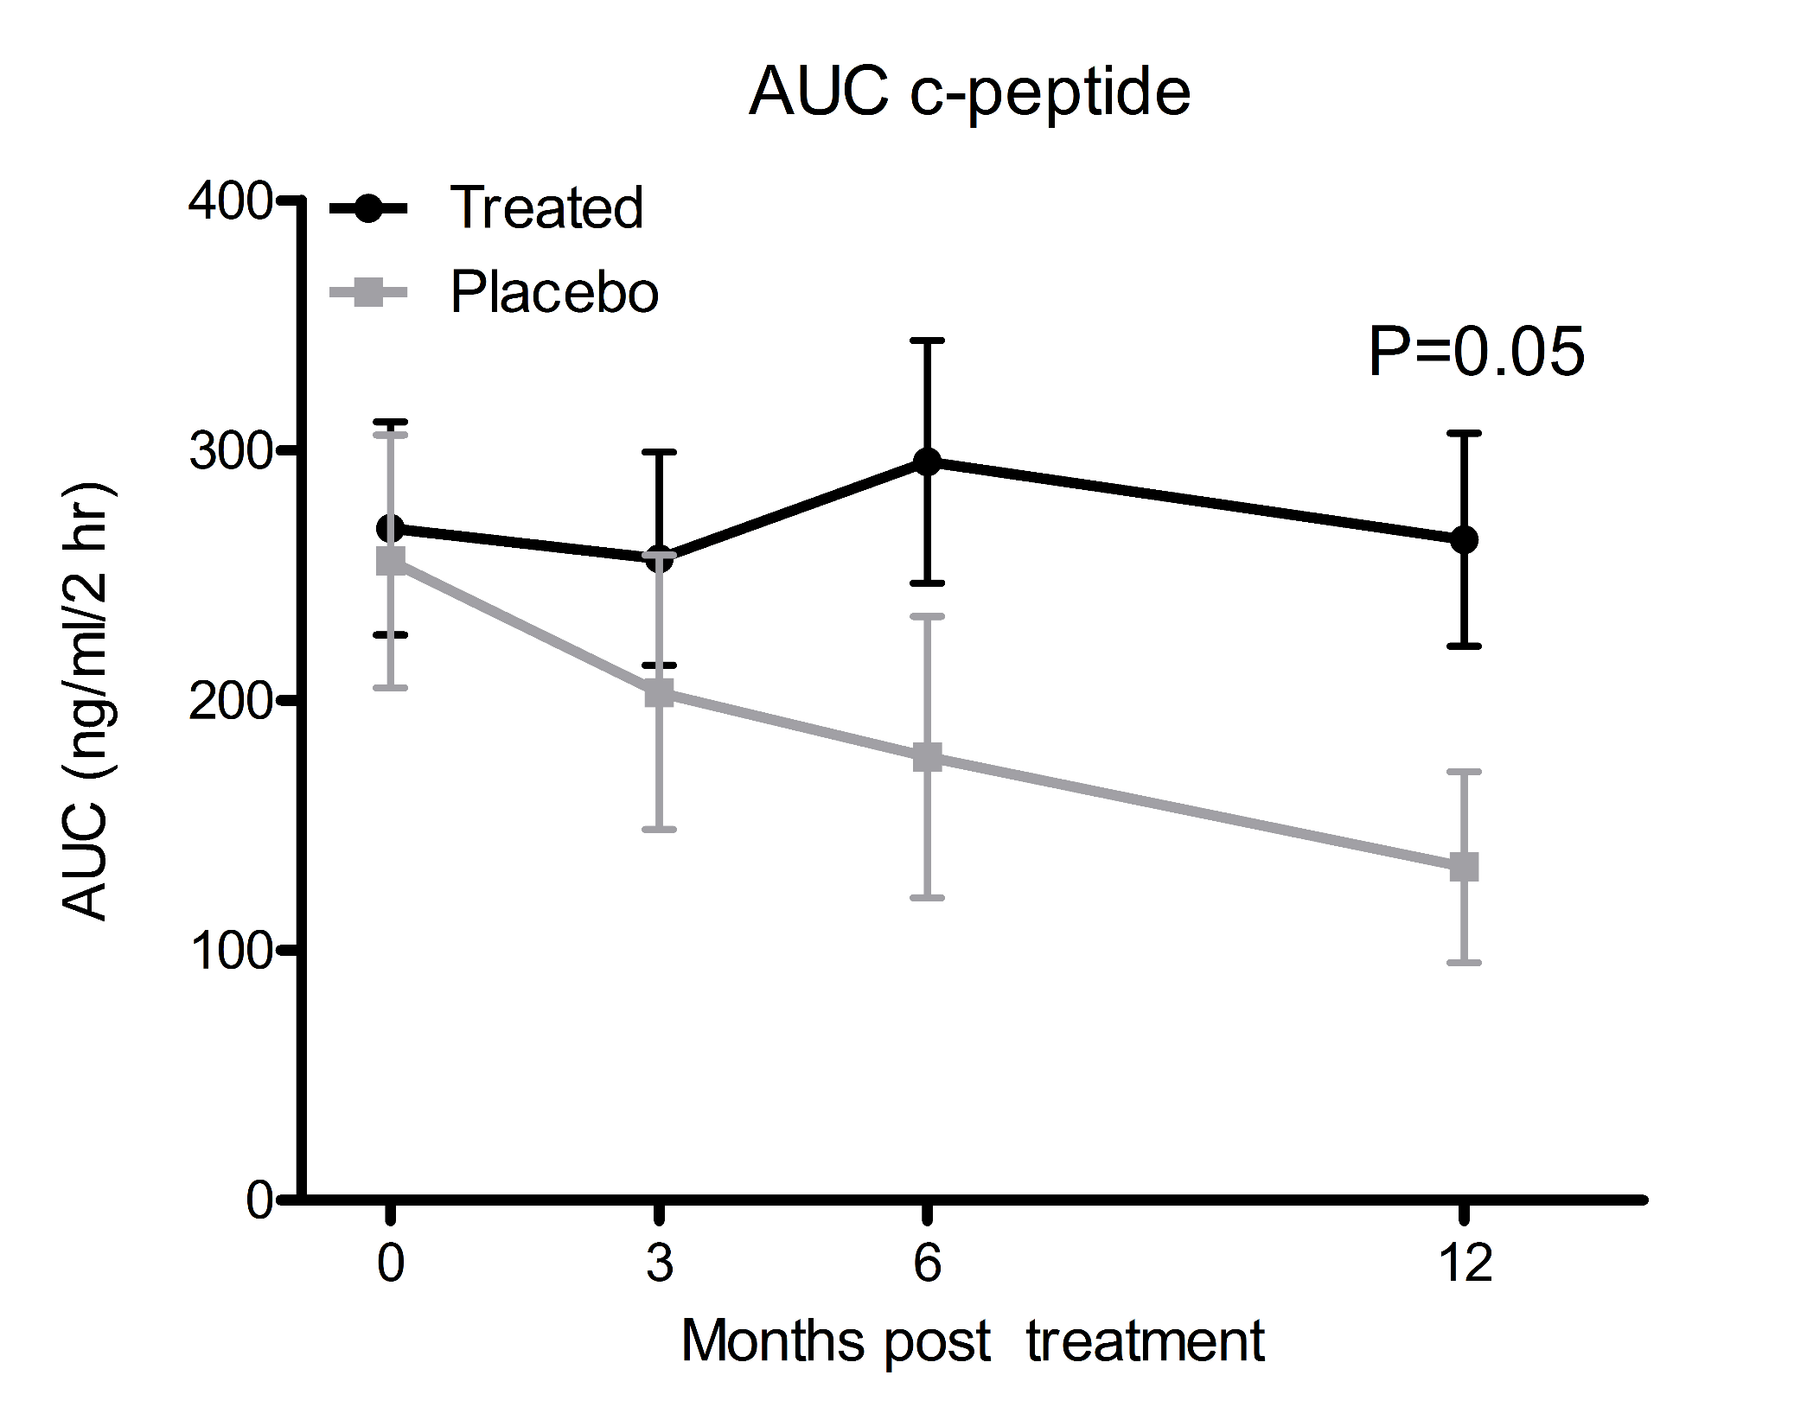

Slide 30
Long-Term Reversal of Hyperglycemia in Experimental Type 1 Diabetes by Inhibition of Smad7 with an Antisense Oligonucleotide
GED-0301 (Giuliani, S.p.A.): synthetic single stranded DNA oligonucleotide that targets sequence 403–423 of human Smad7 mRNA, a sequence that is 100% homologous in human, mouse, monkey, and other species
A conventional “first-generation AS ODN”: a 21-mer with phosphorothioate linkages (to afford increased exonuclease stability) and two CpG motifs methylated (to eliminate potential immunostimulatory activity)
Selected as lead compound upon in vitro screening on lamina propria mononuclear (LPMN) cells from patients affected by Crohn’s disease (CD)
In vivo efficacy studies in mouse models of colitis
Promising results in early CD clinical trials [Monteleone, G. et al. Mol. Ther. 2012, 20, 870]
GED-0301 (Giuliani, S.p.A.): synthetic single stranded DNA oligonucleotide that targets sequence 403–423 of human Smad7 mRNA, a sequence that is 100% homologous in human, mouse, monkey, and other species
A conventional “first-generation AS ODN”: a 21-mer with phosphorothioate linkages (to afford increased exonuclease stability) and two CpG motifs methylated (to eliminate potential immunostimulatory activity)
Selected as lead compound upon in vitro screening on lamina propria mononuclear (LPMN) cells from patients affected by Crohn’s disease (CD)
In vivo efficacy studies in mouse models of colitis
Promising results in early CD clinical trials [Monteleone, G. et al. Mol. Ther. 2012, 20, 870]
GED-0301 (Giuliani, S.p.A.): synthetic single stranded DNA oligonucleotide that targets sequence 403–423 of human Smad7 mRNA, a sequence that is 100% homologous in human, mouse, monkey, and other species
A conventional “first-generation AS ODN”: a 21-mer with phosphorothioate linkages (to afford increased exonuclease stability) and two CpG motifs methylated (to eliminate potential immunostimulatory activity)
Selected as lead compound upon in vitro screening on lamina propria mononuclear (LPMN) cells from patients affected by Crohn’s disease (CD)
In vivo efficacy studies in mouse models of colitis
Promising results in early CD clinical trials [Monteleone, G. et al. Mol. Ther. 2012, 20, 870]

Slide 31
Insulin Implant
Treatment
Long-Term Reversal of Hyperglycemia in Experimental Type 1 Diabetes by Inhibition of Smad7 with an Antisense Oligonucleotide
****
55% (n = 6 out of 11)
GED-0301 (Giuliani, S.p.A.): synthetic single stranded DNA oligonucleotide that targets sequence 403–423 of human Smad7 mRNA, a sequence that is 100% homologous in human, mouse, monkey, and other species
A conventional “first-generation AS ODN”: a 21-mer with phosphorothioate linkages (to afford increased exonuclease stability) and two CpG motifs methylated (to eliminate potential immunostimulatory activity)
Selected as lead compound upon in vitro screening on lamina propria mononuclear (LPMN) cells from patients affected by Crohn’s disease (CD)
In vivo efficacy studies in mouse models of colitis
Promising results in early CD clinical trials [Monteleone, G. et al. Mol. Ther. 2012, 20, 870]
GED-0301 (Giuliani, S.p.A.): synthetic single stranded DNA oligonucleotide that targets sequence 403–423 of human Smad7 mRNA, a sequence that is 100% homologous in human, mouse, monkey, and other species
A conventional “first-generation AS ODN”: a 21-mer with phosphorothioate linkages (to afford increased exonuclease stability) and two CpG motifs methylated (to eliminate potential immunostimulatory activity)
Selected as lead compound upon in vitro screening on lamina propria mononuclear (LPMN) cells from patients affected by Crohn’s disease (CD)
In vivo efficacy studies in mouse models of colitis
Promising results in early CD clinical trials [Monteleone, G. et al. Mol. Ther. 2012, 20, 870]
Insulin Implant
Treatment
****
55% (n = 6 out of 11)

Slide 32
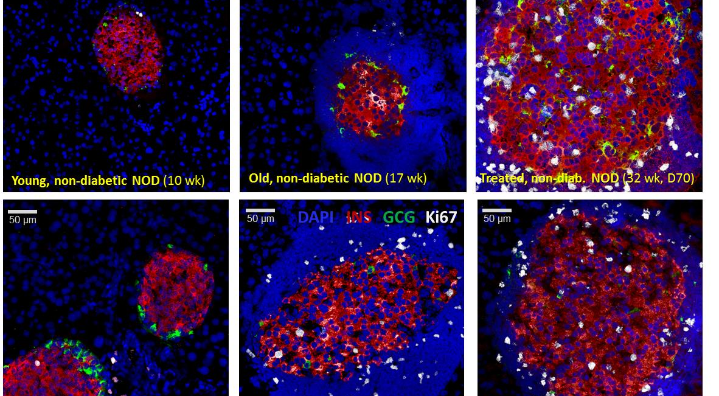
Long-Term Reversal of Hyperglycemia in Experimental Type 1 Diabetes by Inhibition of Smad7 with an Antisense Oligonucleotide

Slide 33
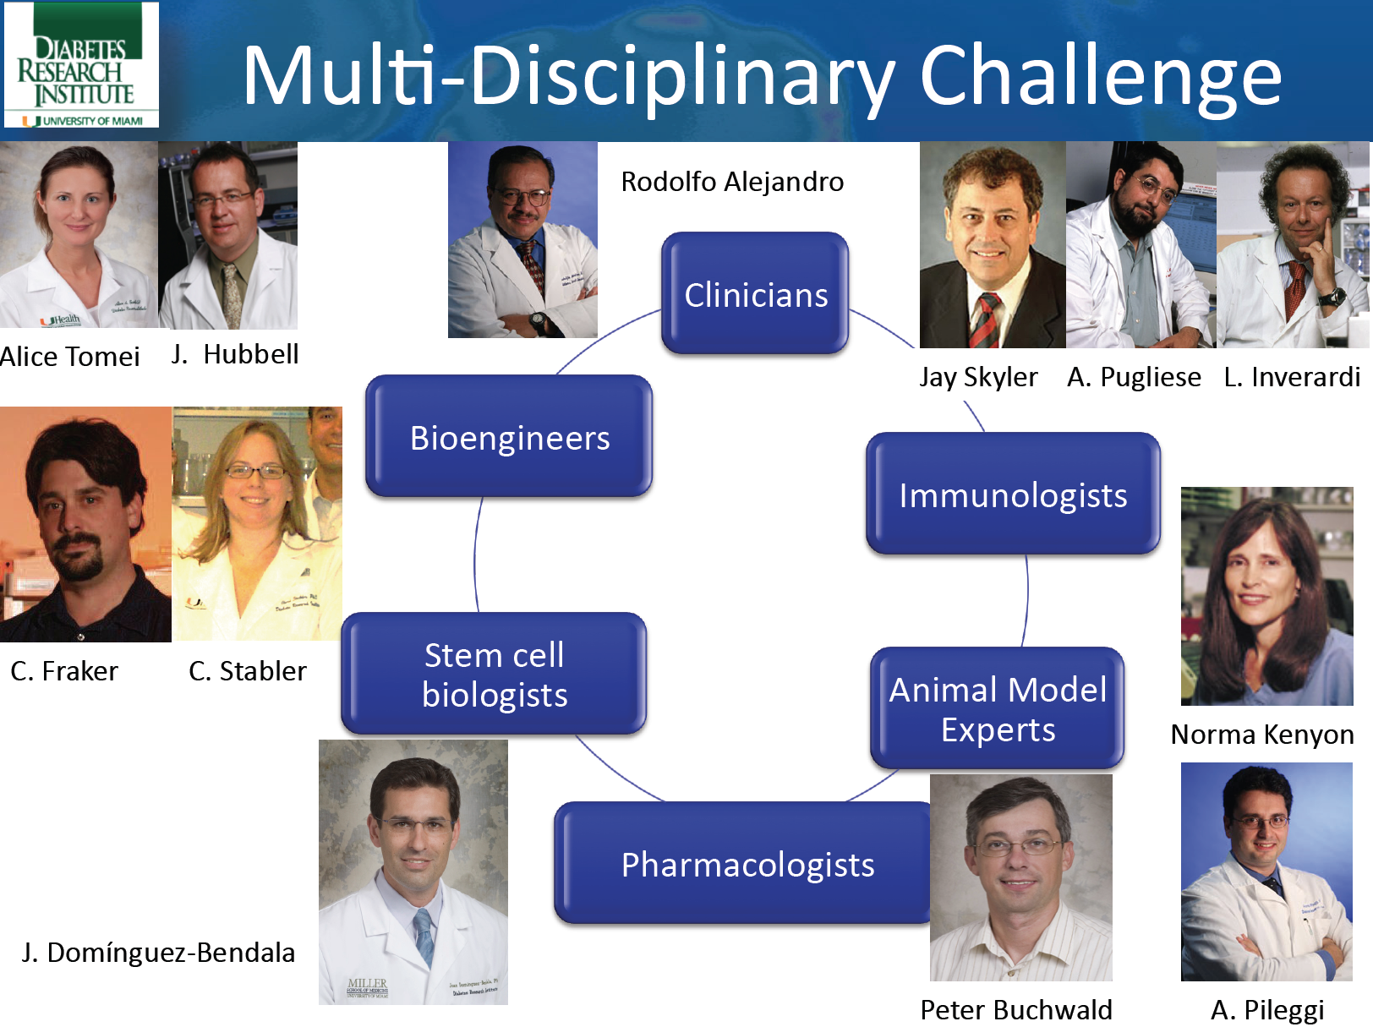

Slide 34
Acknowledgments
DRI
External Collaborators
DRI Federation
Luca Inverardi
Rodolfo Alajandro
Jay Skyler
Antonello Pileggi
Norma Kenyon
Peter Buchwald
Cherie Stabler
Alice Tomei
Christopher Fraker
Juan Dominguez-Bendala
Ricardo Pastori
Alberto Pugliese
Armando Mendez
Elina Linetzky
Xiumin Xu
Giacomo Lanzoni
Fanuel Messaggio
Marta Garcia Contreras
  Suzanne Ildstad
  Jeffrey Hubbell
  Melody Swarts
  Janming Tan
  Massimo Trucco
  James Shapiro
  Lorenzo Piemonti
  Paola Maffi
  Federico Bertuzzi
  Mario Marazzi

Slide 35







Jianming Tan, M.D., Ph.D.
Weizhen Wu, M.D.
Lianming Liao, Ph.D.
Feng Zheng, M.D., Ph.D.
Jin Chen, B.S.
Shunliang Yang, M.D.
Jinquan Cai, M.D.
Xin Gao, M.D,
www.DiabetesResearch.org
Camillo Ricordi, M.D.
Xiumin Xu, M.S.
Shari Messinger, Ph.D.
Antonello Pileggi, M.D., Ph.D.
Gianluca D’Ippolito, Ph.D.
Paul Schiller, Ph.D.
Funding Source:
Key Science Research Project (2009Y4001), Fujian Province, China
Key Laboratory (2008J1006), Fujian Province, China
Gaetano Ciancio, M.D.
George W. Burke III, M.D.
Rodrigo Vianna, M.D.

Slide 36

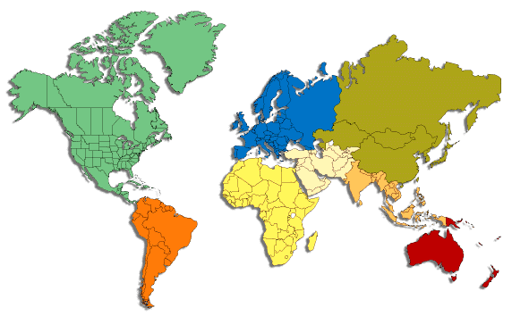
DRI FEDERATION
UMEA
OXFORD
STOCKHOLM
EDMONTON
GENEVE
MILAN, BOLOGNA, ROME, PALERMO
HACKENSACK
TIBLISI
VALENCIA
SHANGHAI-FOUZO
MANAGUA
MIAMI
TEL AVIV
SEOUL
KYOTO
SAN PAULO
BUENOS AIRES

Slide 37








www.diabetesresearch.org

Slide 38
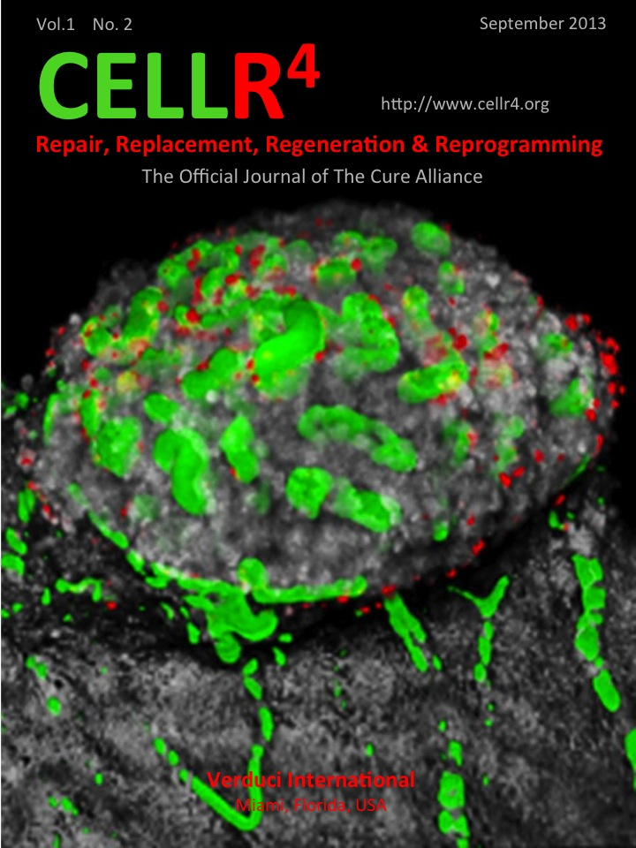

www.CellR4.org
The Cure Alliance An international not-for-profit association of scientists, physicians and committed individuals who share the vision to promote international collaborations while overcoming the impediments and barriers to the development of cures for disease conditions now afflicting humankind
Facebook: The Cure Alliance
Twitter: @CureAlliance

